Slide 1
Credit Card Customer Segmentation

Slide 2
List of content
Business Problem
Data Question & Stakeholders
Data Insights
Data Modeling
Conclusion
Next Steps

Slide 3
Business Problem
Bank wanted to restructure their credit card offering with a more targeted approach based on existing data.

Slide 4
Data Question
Based on the data given, identify different customer clusters
Stakeholders
Marketing Department
Cards Department
Loans Department

Slide 5
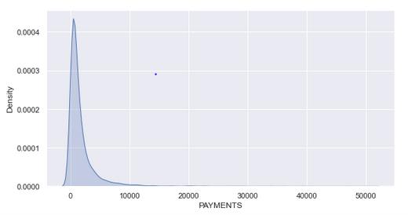
Data Insights
~9000 records
Credit cards customer behavioral features
Data is skewed based on observation
Outliers

Slide 6
Data Modeling - Methodology
Dataset Preparation
Principle Component Analysis (0.95)
Modelling
K-means
Hyperparameter Tuning
Elbow Method
Silhouette Score
Agglomerative Clustering
Visualization
Dimensionality Reduction using PCA
Scatterplot

Slide 7
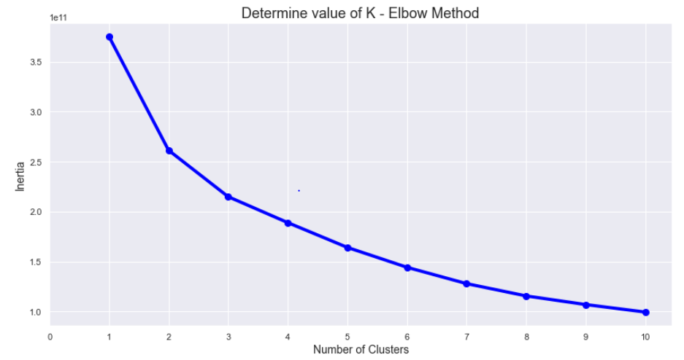
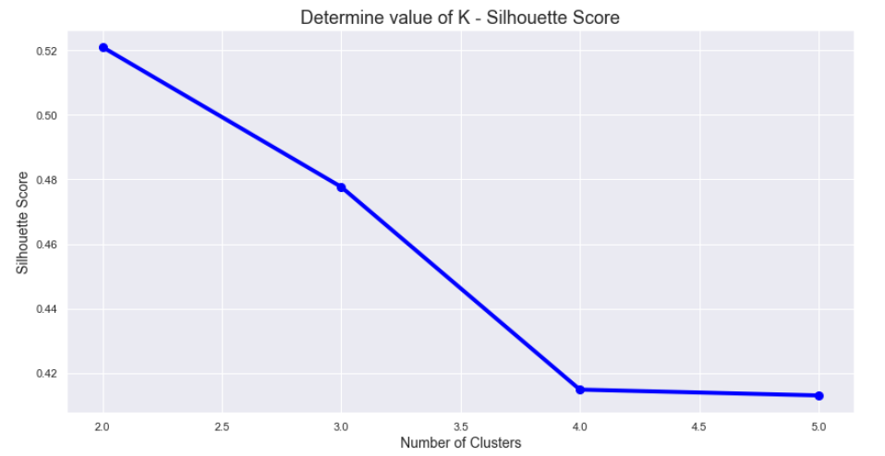
Data Modeling – Hyperparameter Tuning (K-Means)

Slide 8
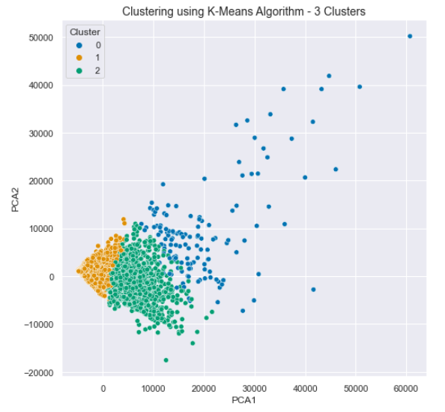
Conclusion
Best Model: K-Means (3 Clusters)

Slide 9
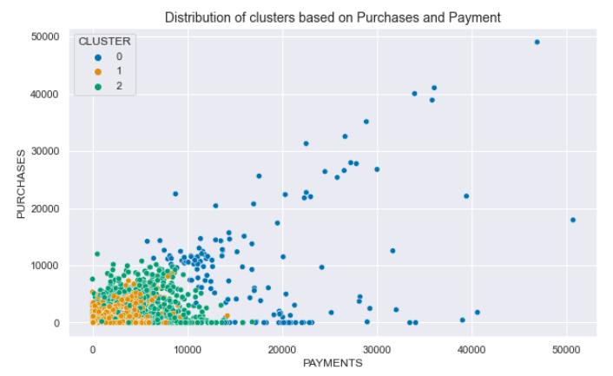
Conclusion
Cluster 0: Customer with high number of purchases
Cluster 1: Customer with low number of purchases
Cluster 2: Customer with moderate number of purchases

Slide 10
Next Steps
Gather time series data
E-purchases data
Purchase category data
Evaluate the results further
Try modeling with other clustering algorithms

Slide 11
The End

